Slide 1

Leverage the CDISC Data Model to Streamline Analytical Workflows
Kelci J. Miclaus, Ph.D.
Research and Development manager
JMP Life Sciences
SAS Institute, Inc.

Slide 2









Introduction
SAS Clinical Research Information Flow
Dictionary coding
(TMS)
External metadata
(RDF, OWL, etc.)
EDC (Rave)
SDTM
ADaM
Others
Submission data sets
Adapters / Interfaces
SAS Clinical Data Integration
SAS Drug Development
Tables, figures and listings
EDC (Other)
Metadata
ePRO and others
Adapters / Interfaces
Metadata, integration and standardization management
Data and analytics platform
Internal systems
Adapters / Interfaces
Pooled analyses
Labs and other external sources
Raw data
JMP
Clinical
SAS Visual Analytics
Transparency initiatives
Patient Profiles/ Medical Review/RBM
CDISC
Exploration across and beyond trials
Real-world data
Raw data

Slide 3
JMP Clinical
Leveraging CDISC in analytical workflows
Integrated solution of JMP and SAS platforms
All analyses built on SDTM/ADaM standards.
Build Clinical Reviews for variety of consumers:
  Medical Monitoring
  Signal Detection
  Data Quality and Fraud Detection
  Risk Based Monitoring
Patient Profiles and auto-generated Adverse Event Narratives
Open system of SAS programming macros to allow for consumer customization

Slide 4
JMP Clinical
Solution provides…
Statistically-driven, dynamic data visualization that is key to efficient clinical review
Data standards support for streamlined/standardized analyses that enable clinicians, data monitors, data managers, and statisticians
Tools for snapshot comparison accelerate reviews
Integrations with broader SAS solutions (Metadata Server, CDI, SDD)

Slide 5
JMP Clinical Data management
Efficient reviews through snapshot comparison
Comparisons between current and previous data snapshot accelerate clinical review to avoid redundant work effort
Keys allow record-level and subject-level categorization to flag new and updated data
  Record-level: New, Modified, Stable, Dropped, Non-Unique (Duplicate)
  Subject-level: New Records, Modified Records, Stable, Introduced
Keys are system-defined based on CDISC Key recommendation or user-generated
Notes:
Metadata defined by sponsor: which can easily be saved to SAS data set with a PROC SORT

Slide 6
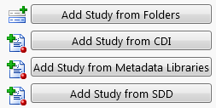
JMP Clinical
Integration with SAS Drug Development (SDD)
Enable JMP Clinical users to access study data stored in SDD
  No web login or drive-mapping required
Snapshot of most current version of files in SDD
  Future version will enable users to select “as-of” date
Supports SDD 3.x
  future version of integration to support 4.x

Slide 7
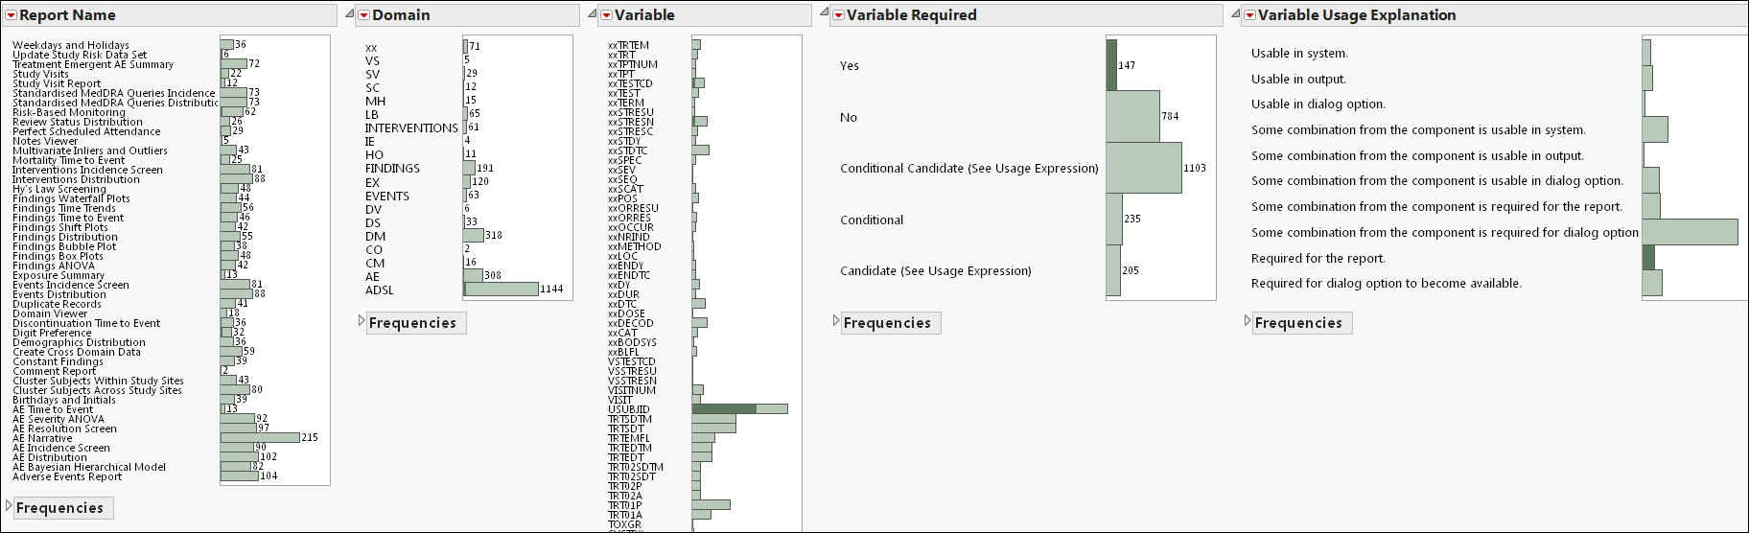
JMP Clinical
Leveraging the Standards
CDISC variable usage architecture:
  Tracks all SDTM/ADaM variable usage (required and optional) in analysis reports
  Documents variable specifications with pre-/post- study data tables and reports, variable narratives, and in analysis report dialogs
  Executes algorithmic logic to restrict availability of analysis reports for studies based on variable requirements
Notes:
Nearly 2500 unique use cases of SDTM/ADaM variables (not inclusive of logic to handle analogous ADaM BDS findings variables)

Slide 8
Live Demonstration
  CDISC Variable Usage
  Clinical Starter Menu
  Review Builder
  Patient Profile and Narratives

Slide 9
Patient profile Report

Slide 10
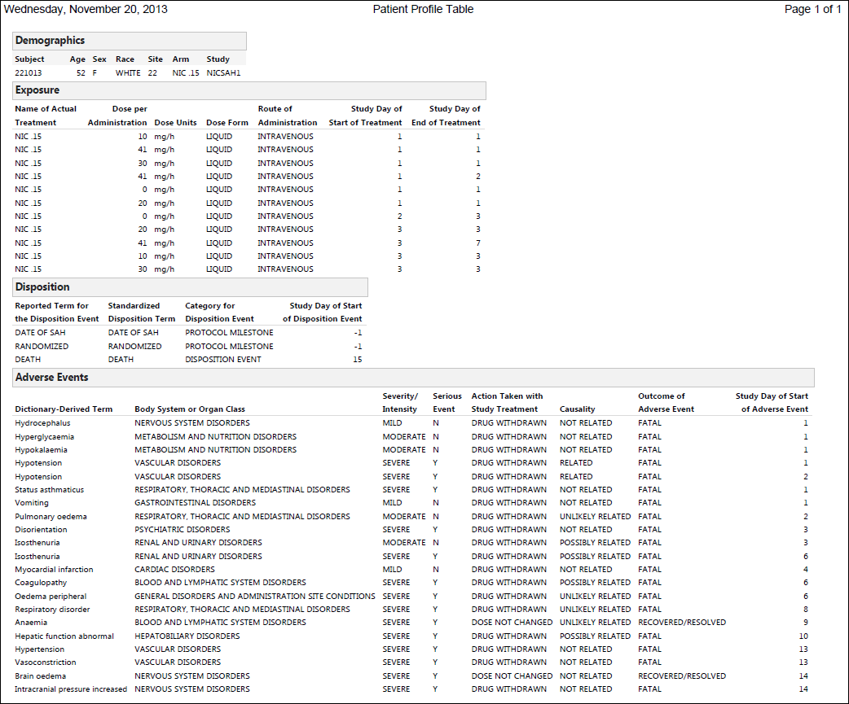
Patient Profile Tables Report

Slide 11
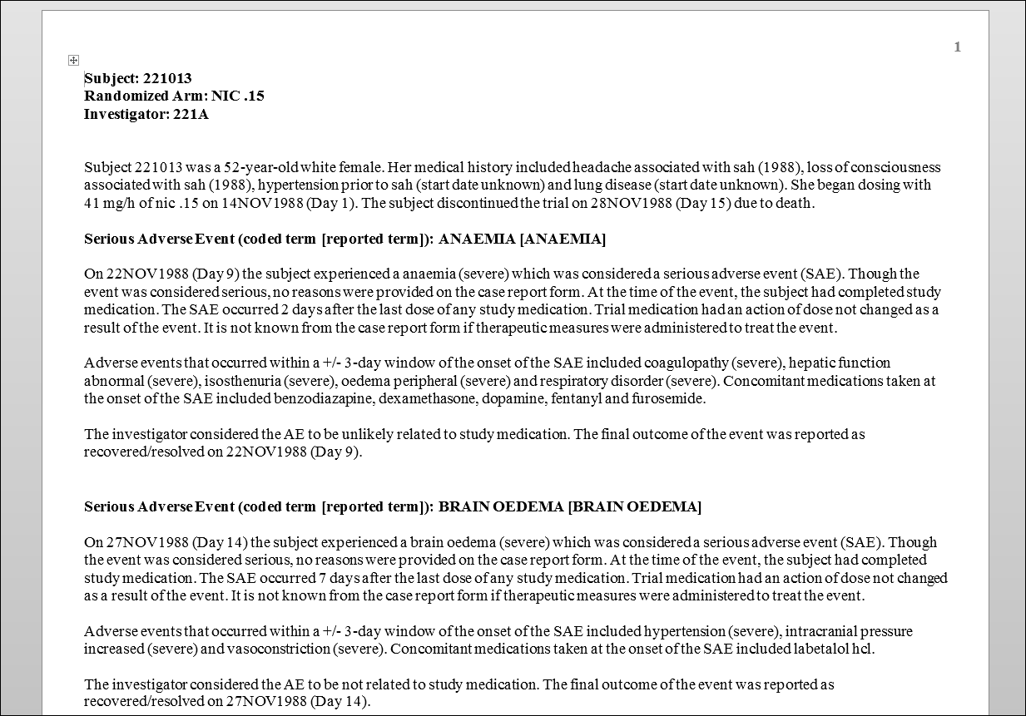
JMP Clinical Reports
Auto-Generated AE Patient Narratives

Slide 12
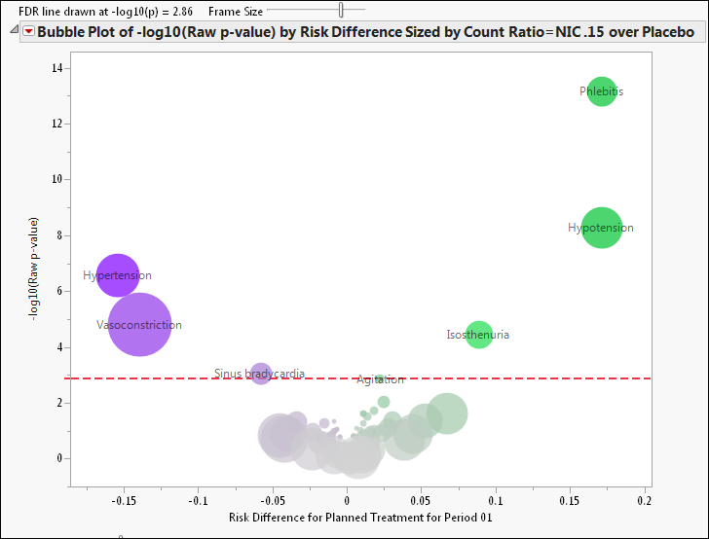
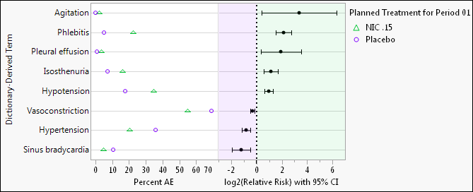
JMP Clinical Signal detection
Safety signal detection
Statistically-driven volcano plots (Jin et al. 2001, Zink et al. 2013)
Space-constrained view of several hundred AE events
Difference in observed AE risk vs. statistical significance
Color illustrates direction of effect
Bubble size reflects AE frequency
Traditional relative risk plot (Amit et al. 2008) to display interesting signals

Slide 13
JMP Clinical Signal detection
Analysis complexities addressed with JMP Clinical
Abundance of endpoints (multiplicity)
  False discovery rate (FDR) Benjamini & Hochberg (1995)
  Double FDR (Mehrotra & Heyse 2004, Mehrotra & Adewale, 2012)
  Bayesian Hierarchical Models
Repeated/recurrent events
  Inclusion of time windows across analyses
Trial design complexity
  Crossover analysis and visualization
Limited population and understanding of biological underpinnings
  Cross-domain predictive models
  Subgroup analysis
  Pharmacogenomics

Slide 14
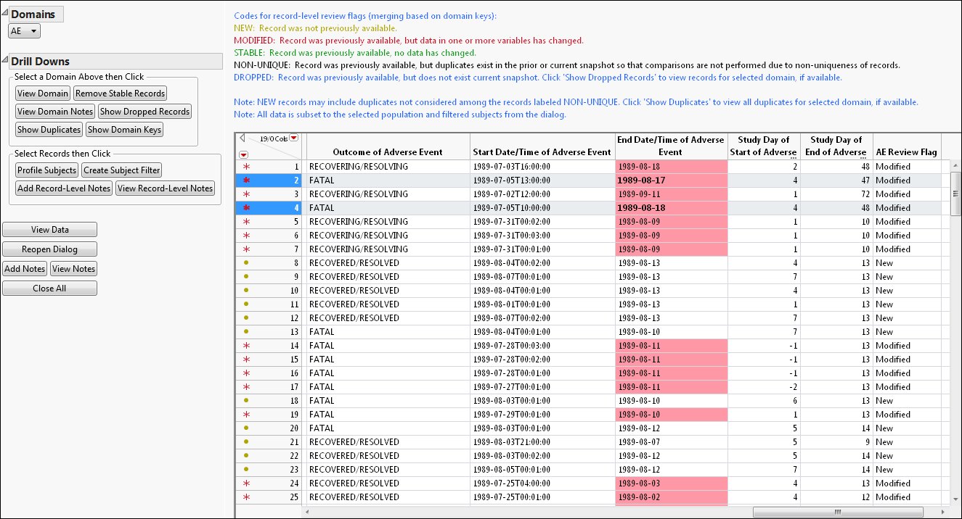
JMP Clinical Data management
Snapshot comparison analysis tools
Domain Data Viewing
  Use of color/annotate New, Modified, and Stable records
  System-generated record-level notes describe changes in variables

Slide 15
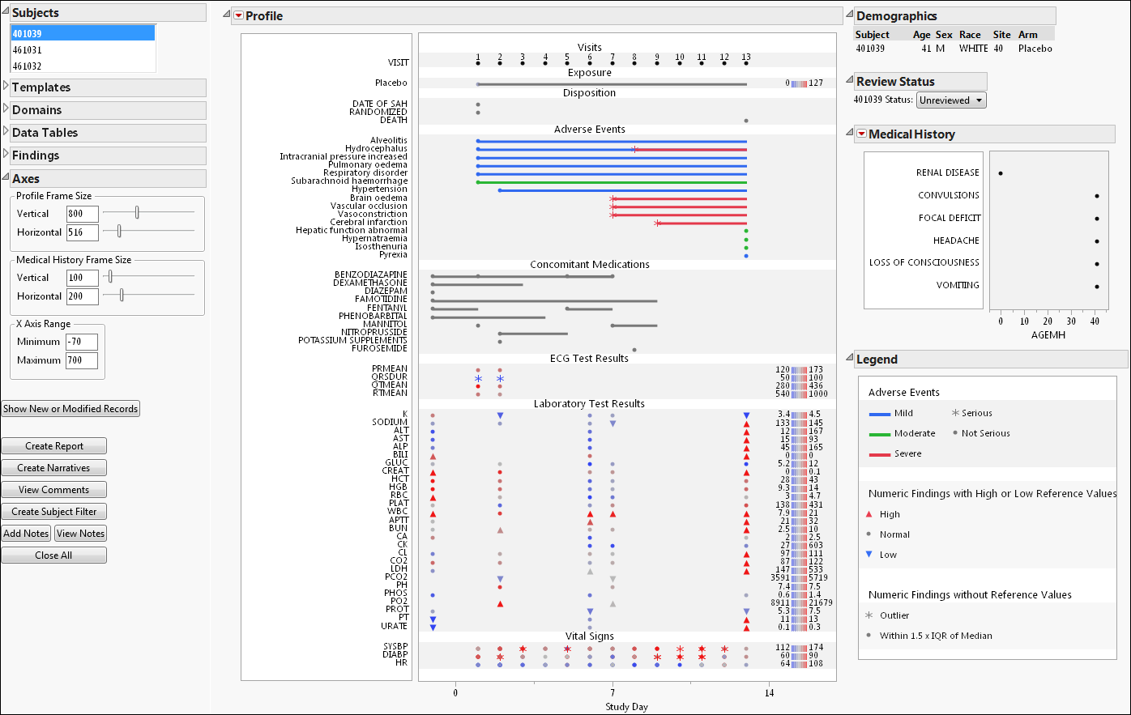
JMP Clinical Data management
Snapshot comparison analysis tools
Track data/record updates and review status at subject level patient profile

Slide 16
JMP Clinical Data management
Snapshot comparison analysis tools
Use derived flags to filter analysis views to see modified/new data
Compare distributions of new versus previous records

