Slide 1
Power BI + R Visuals
Made Easy for Medical Cross Review
覃晓津 Celine Qin
缔结创新之脉，助力成功之道
Increase the probability of your products’ success

Slide 2
How do you usually cross check your clinical trial data?
Whether cross review costs you a lot of energy and time?

Slide 4
Agenda
Background
Demo: Power BI+R cross review
Q&A
How to use Power BI
Page 4

Slide 5
Background
Page 5

Slide 6
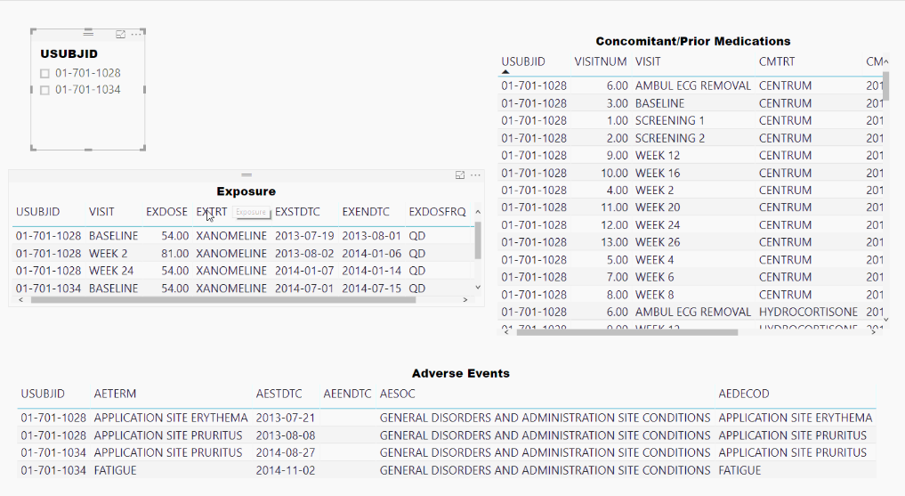
Medical Cross Review
Page 6

Slide 7
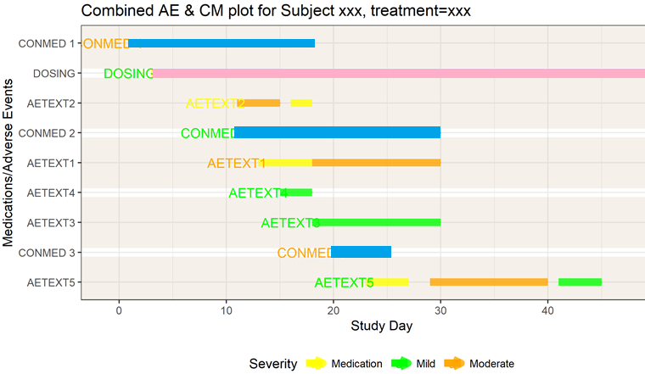
Medical Cross Review
Page 7

Slide 8
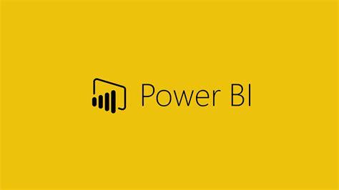
Tools for Data Review
Page 8

Slide 10
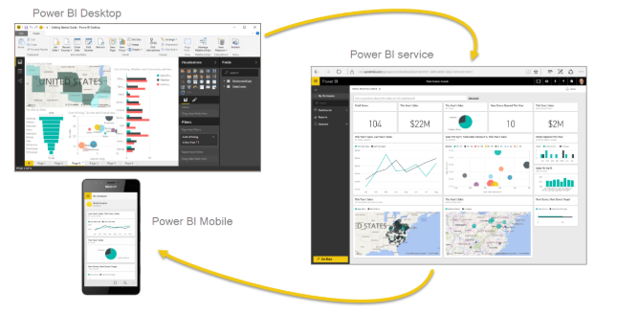
Power BI
A Windows desktop application called Power BI Desktop
An online SaaS (Software as a Service) called the Power BI service
Power BI mobile apps for Windows, iOS, and Android devices
Page 10

Slide 11
Advantages of Power BI
Easy to use
Data analysis
Data visualization
Low costs ☺
Power BI provides multiple touch points for R*
Allows R scripts as data sources
Data transformations as part of Power Query steps
R visualizations
* R is a free software environment for statistical computing and graphics
Page 11

Slide 12
How to use Power BI
Page 12

Slide 13
Power BI Work Flow
Get Data
Set Relationship
Visualization
Page 13

Slide 14
Get Data
2
Files
Excel/text/csv/xml/JSON/SharePoint folder
Database
SQL Server database/Access Database/Oracle database/…
Azure
Azure SQL database/…
Online Services
Power BI service/ SharePoint Online List/Google Analytics/Adobe Analytics/…
Other
R script/ODBC/HDFS/…
Page 14

Slide 15
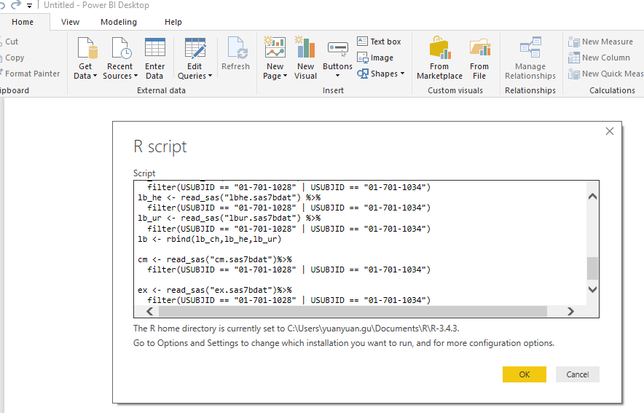
Power BI+ R Scripts
WHY R?
R scripts to read SAS datasets, do data wrangling
Page 15

Slide 16
Set Relationship
2
Types of relationship (Cardinality)
One to One(1:1)
One to Many(1:*)
Many to One(*:1)
Cross filter direction
Single
Both
Page 16

Slide 17
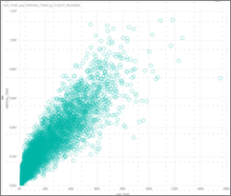
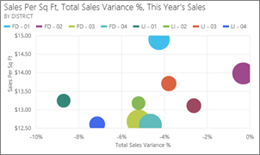
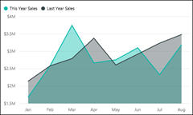
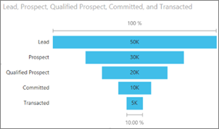
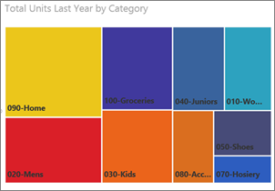
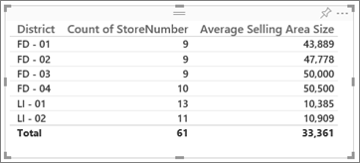
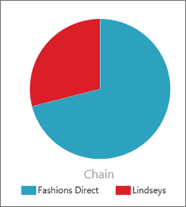
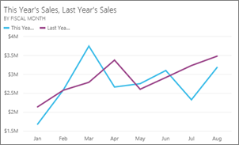
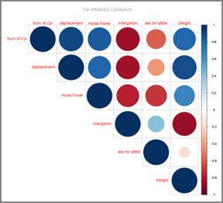
Visualization
3
Visualizations available in Power BI
Built-in
Table
Treemap
Chart
Pie chart
Scatter and Bubble chart
Scatter-high density
R powered visuals
Custom visuals
Page 17

Slide 19
Demo
Power BI+R cross review
on safety datasets: DM, AE, CM, EX and LB
Page 19

Slide 21
Share Report
Publish your reports to the Service, to the cloud and then you can share it with others
Page 21

Slide 22
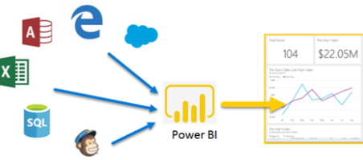
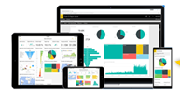
Power BI for Medical Cross Review
Report Creation
Connect to clinical data and create listings and visuals using Power BI Desktop
Publish those reports to the Power BI service
Report Review
Review data and visuals on Power BI service to make medical decisions
Page 22

Slide 23
Reference
https://docs.microsoft.com/zh-cn/power-bi
https://docs.microsoft.com/en-us/power-bi
https://www.r-project.org
Page 23

