Slide 1
SAS Report Writing Interface vs R Markdown for Patient Profile Generation
Qin Meng
缔结创新之脉，助力成功之道
Increase the probability of your products’ success
August 31, 2019

Slide 2
Bio
Qin Meng, Associate Manager, Statistical Programming from dMed
Nine years of clinical programming experience, covering many therapeutic areas, especially oncology studies.
Responsible for Clinical Study Report in CDISC
Developing the programs for CDISC datasets automation, Patient Profiles, Study Oversight for data monitoring etc.
New employee trainings

Slide 3
Process of Patient Profile Generation
SAS ODS Report Writing Interface
RMarkdown in RStudio
Conclusion

Slide 4
Process of Patient Profile Generation

Slide 5
Patient profile
Patient profile report for the clinical trial studies displays the collected original data and information within tables or graphs.
One patient profile report is generated for only one patient.
According to the types or purposes of different clinical trials, different designs will be performed for the patient profile.

Slide 6
Generation Process
Patient Profile
Step 1
Step 3
Data extraction
Source Data review
Patient Profile design
Step 2
Validation is needed
Update according to the requirements (from customer)
Subject ID selection
Run the program to generate the report (SAS ODS RWI/Rmarkdown)
File format conversion, usually PDF is reasonable

Slide 7
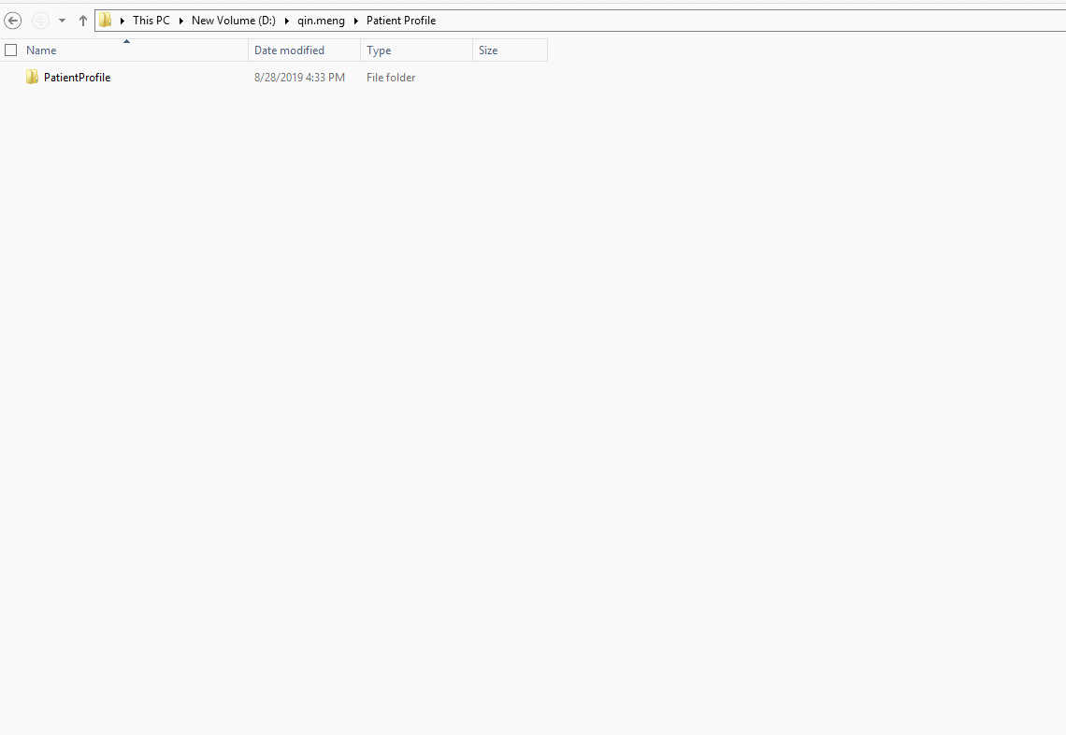
Generation Process

Slide 8
Generation Process – Profile Design
Different clinical trials, different designs
For Phase I, dose escalation and research studies, the researchers will show their interests to the patients’ adverse events especially the DLT (dose limited tolerate) events. For these purposes, the patient profile will be designed to display their safety status and DLT events on the cover page, and better to include more details for the parts of safety in the report
For data monitoring and data quality review, the patient profile report needs to be designed for the CRF (case report form) data, as much as collected data should be included and it’s better to be sorted by visits in the reporting file.
For oncology studies, the PFS and OS related results and RECIST (Response Evaluation Criteria in Solid Tumors) results are expected to be collected, calculated and displayed on the cover page, as well as in the tumor assessment parts in the report.

Slide 9
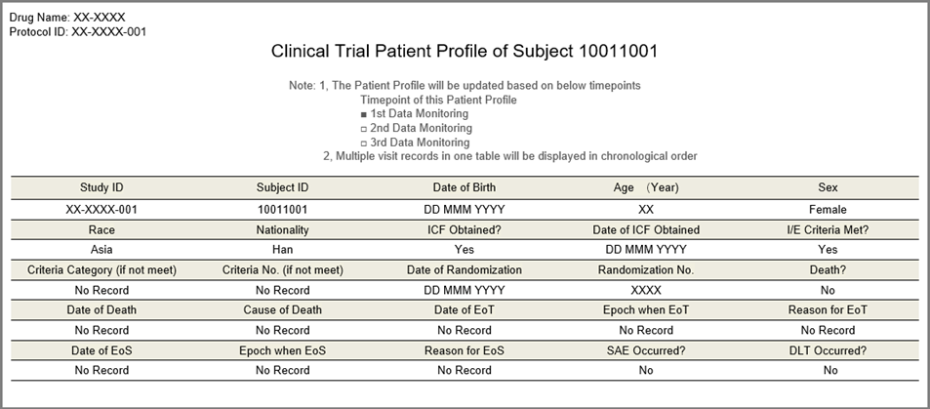
Generation Process
Cover Page of Patient Profile
Shows the basic and key information of subject in clinical trial studies

Slide 10
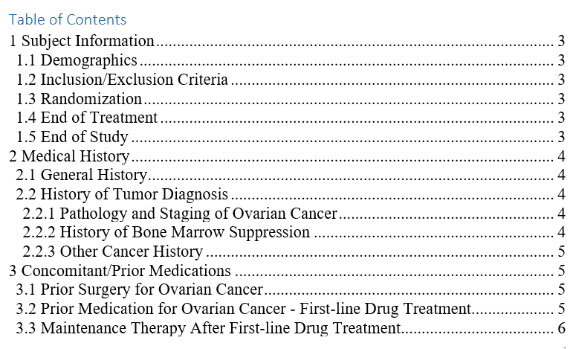
Generation Process - Table of Contents
Table of Contents could be automatically generated by program

Slide 11
SAS ODS Report Writing Interface

Slide 12
SAS ODS Report Writing Interface
Advantages of SAS ODS RWI
Fully embrace ODS features, including fonts, colors, images, lines, titles etc.
Rich programming features of DATA step, including conditional sentences, formatting capabilities, by-group processing, do- loops programming etc.
Object-oriented language, it can provide us the flexibility.

Slide 13
Example – SAS ODS RWI
data _null_;
set class;
by sex name;
where name eq "Thomas";
if _N_ = 1 then do;
dcl odsout obj();
end;
if first.sex then do;
obj.table_start();
obj.head_start();
obj.row_start();
obj.format_cell(data: "Name", row_span: 3, vjust: "B");
obj.format_cell(data: sex, column_span: 4, format: "$gender.");
obj.row_end();
obj.row_start();
obj.format_cell(data: "Age", row_span: 2, vjust: "B");
obj.format_cell(data: "Vitals", column_span: 3);
obj.row_end();
obj.row_start();
obj.format_cell(data: "Height");
obj.format_cell(data: "Weight");
obj.format_cell(data: "BMI");
obj.row_end();
obj.head_end();
end;
bmi = ( weight / ( height * height ) ) * 703;
obj.row_start();
obj.format_cell(data: name);
obj.format_cell(data: age);
obj.format_cell(data: height);
obj.format_cell(data: weight);
obj.format_cell(data: bmi, format: "8.2");
obj.row_end();
if last.sex then do;
obj.table_end();
end;
run;
ods rtf close;
ods rtf;

Slide 14
Example – SAS ODS RWI

Slide 15
Rmarkdown in Rstudio
Notes:
需要承上启下一下

Slide 16
Rmarkdown in Rstudio
Advantages of Rmarkdown
R Markdown is recommended to generate high quality reports. R Markdown documents are fully reproducible and support dozens of static and dynamic output formats. Fully embrace ODS features, including fonts, colors, images, lines, titles etc.
There is a new definition in Rmarkdown called “code chunks”, R code chunks are surrounded by ```s. We can run each code chunk by clicking the “ ” icon. RStudio executes the code and display the results consistent with our file.
We can also embed plots with R markdown, for example, ggplot can be used to generate visualized and interactive graphs. When you move your pointer to the dots in the plots, the values will be shown accordingly.
Notes:
Play icon

Slide 17
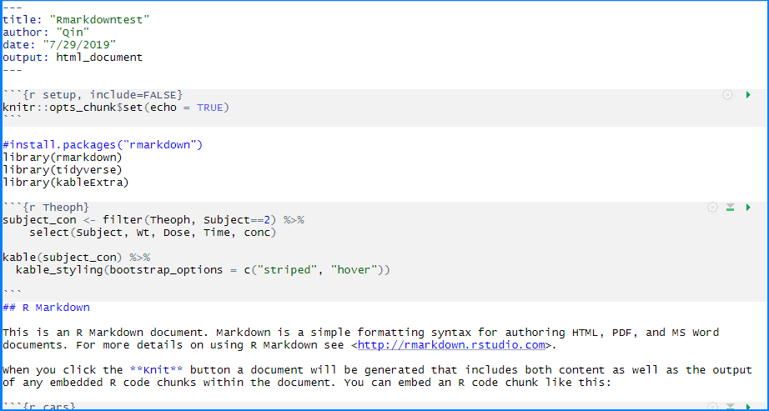
Example - Rmarkdown

Slide 18
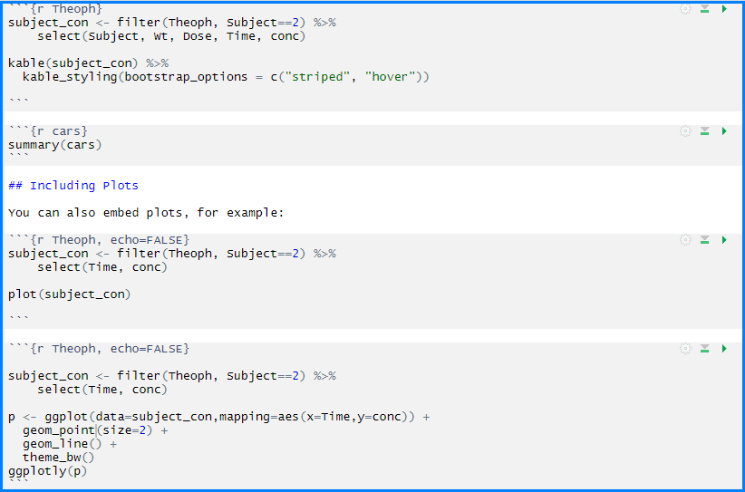
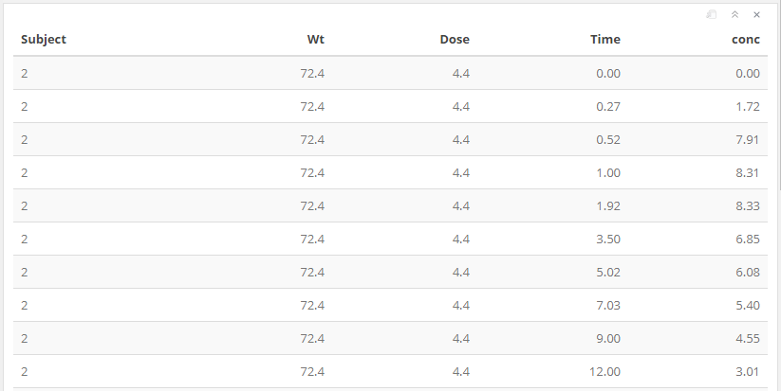
Example - Rmarkdown
Click to run
Click to exit

Slide 19
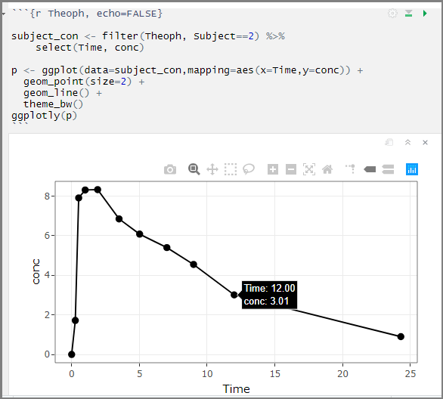
Example - Rmarkdown

Slide 20
Conclusion
Comparing SAS ODS Report Writing Interface with R Markdown for patient profile, both methods have their advantages.
SAS program might be familiar and formal to use and run.
When we want the report in an interactive manner, Rmarkdown is a better choice.
Both SAS ODS Report Writing Interface and R Markdown are suggested to be used in the process of patient profile generation, they always can meet your requirements easily and effectively.

Slide 21
Thank you for
Your Time !
Name: Qin Meng
Company: dMed Biopharmaceutical Co., Ltd.
Address: Wuhan, China
E-mail: qin.meng@dmedglobal.com
Phone: +86 13871387052

