Slide 1
Clinical trial data analysis automation using A Macro called RPA RPA促进临床试验数据分析自动化
Gaoyang LI
PharmaSUG HDE
RPA-robotic process automation

Slide 2
李高扬， 拜耳北京研发中心资深统计分析师
李先生现任拜耳医药北京研发中心资深统计分析师，负责临床研究数据整理，统计分析，结果汇报，帮助医学专业人士发现数据价值。
李先生从事医药研发数据分析11年，其专注的领域包括：数据分析，统计编程，商务智能、可视化分析，机器人流程自动化等。目前李先生是药物信息协会（DIA）青年顾问委员，DIA数字健康社区负责人，多次组织和主持医药研发数字化相关研讨会和沙龙活动，以促进医药研发数字化化转型方面交流。
自2012年起，在DIA和制药行业SAS用户组（PharmaSUG）发表多篇医药研发数据分析文章，并为PhUSE中交互式可视化分析工作组成员，参与数据分析方面白皮书起草和翻译工作。
李先生曾担任拜耳北京研发中心创新教练（Innovation Coach），积极推广创新思维和医药研发新技术应用。

Slide 3
Digital health – platforms overview
Patient engagement
RWD
DevOps
Tech partners
SaMD
Health ecosystems
platforms
Research partners
Customer experience
platforms
Apps
Patients and HCP
Ecosystems
Regulators/Safety
Analytics
RWE
MDM
Big data
AI
Things
IT systems
Devices
Robots
IoT Platforms
R&D Platforms
Wearables
Cloud / SaaS
From documents to data
Digital pills
From systems to platforms

Slide 4
IoT in Clinicalt Trials
DIGITAL HEALTH
Participants
Active time
Real time
Inclusion
Device
Study start
SENSOR CAPTURE
Heart rate monitor
Accelerometer
Barometer pressure
Humidity
Voice
Sleep activity Respiratory rate Blood Pressure
Imaging – Photos
Stress
SENSOR CAPTURE
PROs Specific.
Examples – Psoriasis
Questionnaire
Inventory Symptoms
Patient Benefit Index
Skindex – Photo/AI
Analytics
ML & AI
BIG DATA
Insights & Trial Report
INTEGRATIONS

Slide 5
Clinical Study Accelerator - Delivery Model
Trial Preparation
During Trial/Submission
Scope
Device
CSA
Run
Evaluate
Define objectives
Device
Streaming
Storage
Deployment
Production
Evaluate
Integration
Scope
Goals
Use Case Analysis
Selection
Qualification
Management
Secure data tranfer
Pre- Configured
Load Analysis
Controls
Processors
Pre-Configured
Storage Analysis
Data Flows
One click deploy
Environments planning and definition.
Collect data
Monitor
Compliance assesment
Evaluate data flows
Computational
Storage
Backup

Slide 6
Automation Level
1) inline functions,
2) in-dataset procedures,
3) in-system Macros,
4) in-computer RPA,
5) in-real-world AI.

Slide 7
The “Macro Mindset”

Slide 8
Using VBA in Microsoft Excel for Data Analysis Automation
1
Understand the Context of Your Automation Project
VBA solutions are ideal when saving money is a high priority.
VBA solutions are highly flexible.
VBA solutions are best when maintained and used by as few users as possible.
The vast majority of VBA solutions are written in Excel.
Smaller companies generally have more opportunities for VBA than larger companies.
VBA solutions are only as robust as you make them.
Dealing with VLOOKUPs in VBA
error handling
Using Pivot Tables in VBA
valid, normalized, high-quality data
Efficiently Allocating Your Time
Most of your effort should be spent preparing the data.
Visualize your end result as you build and refine your table.
2
3
3
Notes:
https://simpleprogrammer.com/vba-data-analysis-automation/

Slide 9
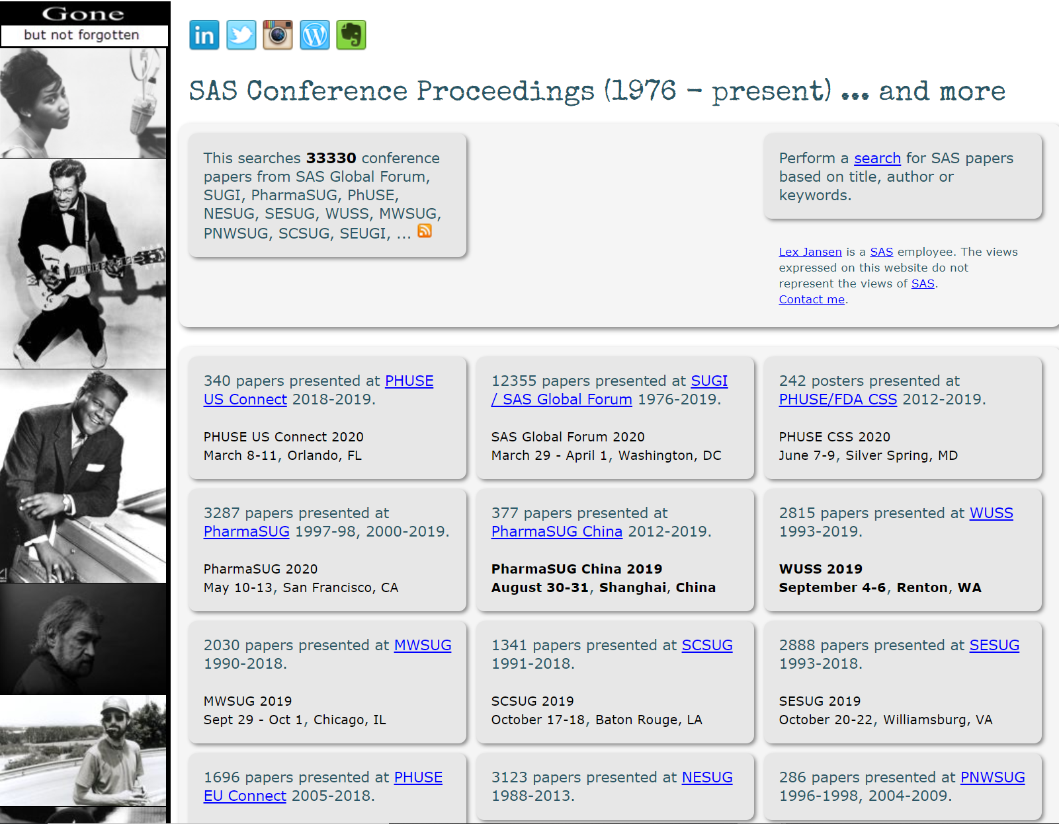
SAS automation
Analytics, Artificial Intelligence and Data Management | SAS

Slide 10
RPA automation
传统医药研发数据分析从提出数据分析需求到获得分析结果周期漫长，流程复杂，医学专业人士严重依赖静态分析报告，无法直接从数据获取洞察。在数字化时代，医药大数据源源不断，真实世界数据维度无穷，AI技术广泛应用，传统医药研发数据分析模式不再适宜，自助式分析崛起。

Slide 11
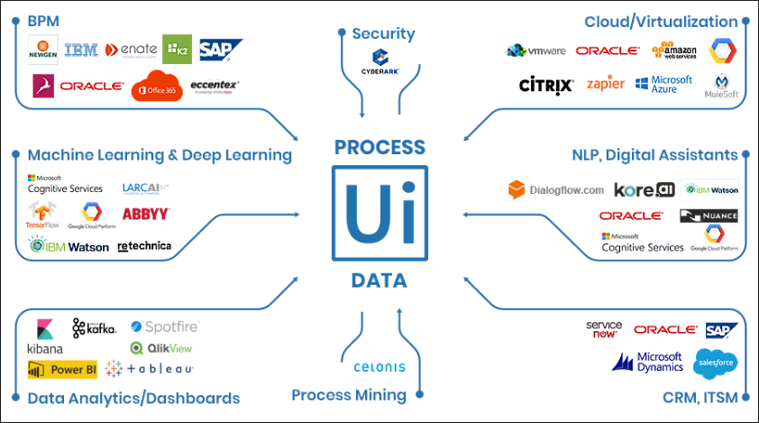
Why Use RPA
RPA
AI
It is a path
It is a entity
It is easy
It is complex

Slide 12
RPA introduction, take Uipath as an example

Slide 13
RPA introduction, take Uipath as an example
1
UiPath Studio is a complete solution for application integration, and automating third-party applications, administrative IT tasks and business IT processes. One of the most important notions in Studio is the automation project.
A project is a graphical representation of a business process. It enables you to automate rule-based processes, by giving you full control of the execution order and the relationship between a custom set of steps, also known as activities in UiPath Studio. Each activity consists of a small action, such as clicking a button, reading a file or writing to a log panel.
The main types of supported workflows are:
Sequences - suitable to linear processes, enabling you to smoothly go from one activity to another, without cluttering your workflow.
Flowcharts - suitable to a more complex business logic, enabling you to integrate decisions and connect activities in a more diverse manner, through multiple branching logic operators.
State Machines - suitable for very large workflows; they use a finite number of states in their execution which are triggered by a condition (transition) or activity.
Global Exception Handler - suitable for determining the workflow behavior when encountering an execution error, and for debugging processes.
2
3

Slide 14
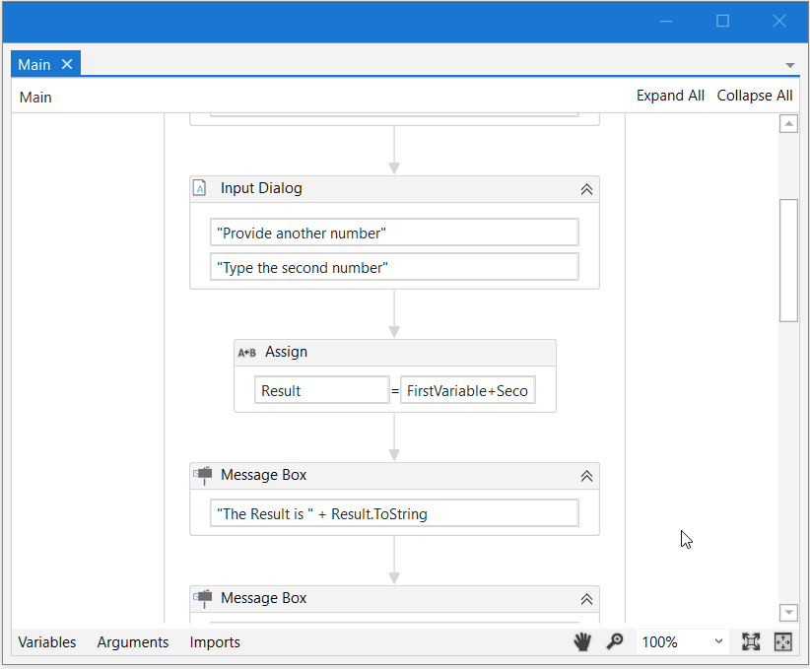
Visual flowchat

Slide 16
How to learn RPA?
1
2
3

Slide 17
More questions about RPA(Uipath)
Let’s learn together
Go to Uipath academy to learn the course
Visit the Uipath documents
Go to free Uipath training
You can go to Udemy for payed course as well

