Slide 1
Reading and Resolving OpenCIDSC Message
Penny Pang, Novartis

Slide 2
Background
About OpenCDISC

Slide 3
About OpenCDISC
An open source community focused on building extensible frameworks and tools for the implementation and advancement of CDISC Standards.
OpenCDISC is used by the FDA in the acceptance process of a CDISC submission.
Most updated version is v2.0.2
Easy to use
Free

Slide 4
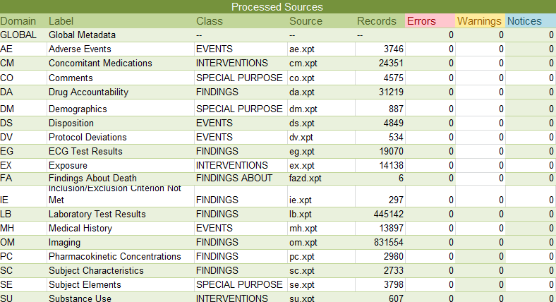
OpenCDISC: Bitter and Sweet
When we open the OpenCDISC report, we expect

Slide 5
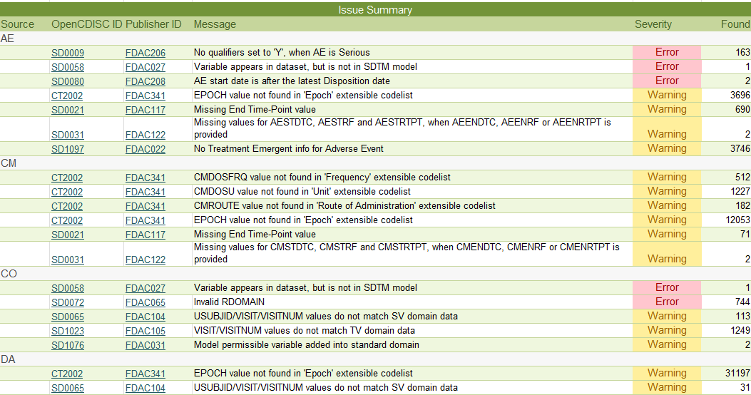
OpenCDISC: Bitter and Sweet
But the truth is...

Slide 6
Type of messages
Error
Warning
Notices
Consistency
Cross-reference
Format
Limit
Metadata
Presence
Terminology
Which type need to be fix? Which type need to be explain?
By Severity
By category

Slide 7
Examples
Message and solution

Slide 8
Type I: Issue caused by OCV
OpenCDISC software bugs
Label match? Label mismatch?
Required Variable missing? Non SDTM variable?
CM | CMTRT, Reported Name of Drug, Med, or Therapy | SD0063 | SDTM/dataset variable label mismatch | Warning
When EPOCH is not included in VS
VS | EPOCH, VS | SD1077 | FDA Expected variable not found | Warning
When EPOCH is included in VS
VS | EPOCH | SD1076 | Model permissible variable added into standard domain | Information
Above issues are already fixed in OCV 2.0.1

Slide 9
Type I: Issue from OCV
OpenCDISC too Strict rule
Insufficient sorting key
OM | VISITNUM, OMEVAL, OMCAT, OMDTC, OMTESTCD, OMLOC, USUBJID, OMMETHOD | 2, READER, SESSION 1, 2012-08-30, EROS, DIP2, 1001001, X-RAY | SD1117 | Duplicate records
OMLAT should also be a key variable expected.
Non-required variable used to check
AE | AESER | Y | SD0009 | No qualifiers set to 'Y', when AE is Serious | Error
Non of the qualifier variable (AESCAN, AESCONG, AESDISAB, AESDTH, AESHOSP, AESLIFE, AESMIE) is collected.
Unit for category parameter
XE | XESTRESC, XESTRESU, XETEST, XETESTCD | 1, null, Swollen Joint Total Score, SWJTSCO | SD0029 | Missing value for XESTRESU, when XESTRESC is provided | Warning
Category parameter, no unit necessary

Slide 10
Type I: Issue from OCV
OpenCDISC too Strict rule
Randomized but not dosed
DM | ARMCD, USUBJID | DOSE1, 101001 | SD0070 | No Exposure record found for subject | Warning
Randomized subject not necessary to be dosed
VISIT/VISITNUM inconsistency for Unplan visit
SV | VISITNUM, VISIT | 9.001, UNP_LB | SD0052 | Inconsistent value for VISITNUM within VISIT | Warning
Unplan visit name not exist in TV
Comment in label
PC | PCXXXX | XXXX Comment | SD1120 | Comments in SUPPFA domain | Warning
Comment is only a word in the label

Slide 11
Type II: Issue from Data
Data format
Label inconsistency
SD0063 | SDTM/dataset variable label mismatch | Warning
SD0046 | Inconsistent value for QLABEL within QNAM | Warning
Sequence of variables
SD1079 | Variable is in wrong order within domain | Warning
Check the SDTM IG or OpenCDISC config.
Variable length too long for actual data
SD1082 | Variable length is too long for actual data | Error
Compress the length via actual data

Slide 12
Type II: Issue from Data
Issue caused in submit package
Dataset too large
SD1071 | Dataset is greater than 1 GB in size | Warning
We need to split the xpt when the size > 1GB
Dataset Empty
SD0001 | Domain table should have at least one record | Error
No death case then no need to submit ZD
Pure/SUPP inconsistency
SUPPVS | IDVAR, IDVARVAL, RDOMAIN, USUBJID | VSSEQ, 43267, VS, 1001001 | SD0077 | Invalid referenced record | Error
Reference record not found in Pure

Slide 13
Type II: Issue from Data
Issue caused in submit package
Invalid RDOMAIN
CO | RDOMAIN | ZE | SD0072 | Invalid RDOMAIN | Error
ZE not submitted, but comment collected.
FA (Finding about) datasets
FA | DOMAIN | ZD | SD0004 | Inconsistent value for DOMAIN | Error
SUPPFA | RDOMAIN | ZD | SD0072 | Invalid RDOMAIN | Error
The DOMAIN value would be FA
The dataset names would be the domain name plus up to two additional characters indicating the parent domain
FASEQ must be unique within USUBJID for all records across the split datasets.
Supplemental Qualifier datasets would need to be managed at the split-file level, and RDOMAIN would be defined as FA.

Slide 14
Type II: Issue from Data
Data Issues can be fixed
Invalid subject
EG | USUBJID | 1001001 | SD0064 | Subject is not present in DM domain | Error
Data issue, report to DM and resolved.
Required variable missing
CM | CMTRT | null | SD0002 | NULL value in CMTRT variable marked as Required | Error
CM not coded, report to DM and resolved.
AE: AEDECOD, CM: CMTRT, MH: MHTERM, EX: EXTRT
VS | VSSTRESC VSORRES | Null, 5.71 | SD0026 | Missing value for VSORRESU, when VSORRES is provided | Error
Programming issue when convert unit, fixed

Slide 15
Type II: Issue from Data
Data Issues can be fixed
Redundancy in paired variables values
AE | AECAT,AESCAT | GENERAL, GENERAL | SD1041 | Values for AECAT and AESCAT are identical | Warning
Remove SCAT or remap the SCAT value
Standard unit consistency
LB | LBMETHOD, LBTESTCD, LBSCAT, LBSTRESU, LBCAT, LBSPEC | null, CA, null, mg/dL | SD0007 | Inconsistent value for Standard Units | Error
Remove SCAT or remap the SCAT value
SV inconsistency with other domains
SD0065 | USUBJID/VISIT/VISITNUM values do not match SV domain data | Warning
Reconcile SV

Slide 16
Type II: Issue from Data
Data Issues related with CT
Rule ID | Message | Category | Severity
CT00XX | Value for --XXX not found in (XXX) CT codelist | Terminology | Warning
Non-extensible CT
Must be remapped or check.
Example: SEX, AGEU
Extensible CT
Can be remapped.
Example: Q2W to EVERY 2 WEEKS in UNIT
DEATH to FATAL in AEOUT
XRAY to X-RAY in METHOD
Can be listed in the SDRG.
Example: ECG tests,
Study specific EPOCH

Slide 17
Type II: Issue from Data
Data Issues have to be explained
Data issue because of PD
SE | SESTDTC, SEENDTC | 2012-07-26, 2012-07-12 | SD0080 | SESTDTC is after SEENDTC | ERROR
Special case, re-randomized subject sign IFC after dose, PD entered.
Multi assessment on one day
VS | VISITNUM, VSDTC, USUBJID, VSTESTCD | 1, 2012-03-01, 1001001, PULSE | SD1117 | Duplicate records | Warning
This subject assess twice on the same day.

Slide 18
Type III: Issue from Study
Study specific design
Obs after last disposition
AE | USUBJID, AESTDTC | 1001003, 2014-06-18 | SD0080 | AE start date is after the latest Disposition date
Study specific cut off rule use first dose of extension.
Variable not necessary
ZN | VARIABLE | ZNBLFL | SD1044 | No ZNBLFL variable in custom Findings domain | Warning
ZN only collected on randomization, no BLFL needed
No baseline record
DM | ARMCD, USUBJID | DOSE1, 101001 | SD0006 | No baseline result in EG for subject | Warning
Time used to define baseline EG/LB. Randomize visit maybe regarded as post-baseline.

Slide 19
Issue caused by multi reasons
Real case
Type I issue:
Visit name of unplaned visits are not included in TV, already Explained in SDRG.
Type II issue:
Visitnum not given for some planed visit, data issue, need to report to DM to fix the visitnum and rebuild SV.
A message may caused by different reasons, we must check the detail to prevent hidden type II issue.

Slide 20
Summary

Slide 21
Summary
OpenCDISC message component:
Before：
Type I
Type II
Type III
After：
Most of the type II issues can be identified before DBL and need to be fixed in the submission package.
Type I
Type II
Type III

Slide 22
Summary
We are not able to expect 100% clean OpenCDISC report, but we need to let it as clean as possible.
Generally, We need to recognize type I issue, fix type II issue, explain type III issue.
Preform the OpenCDISC check the sooner, the better, try to have all type II issue fixed before lock.

Slide 23
Name: Penny Pang
Organization: Novartis Pharma Co., Ltd.
Address: Room 402 No. 72 Liangxiu Road
City, State ZIP: Shanghai
Work Phone: 61606270
Fax:
E-mail: yu.pang@novartis.com
Web:
Twitter:

